Slide 1


Portfolio Construction Using Non-Gaussian VaR Estimation and GSEV Approach
Bachelor Thesis Project II
Vinod Gupta School of Management,
Indian Institute of Technology, Kharagpur
Under The Guidance of
Dr Sujoy Bhattacharya,
Vinod Gupta School of Management,
IIT Kharagpur
Presented By
Unnikrishnan Nambiar K
17NA3FP14
Dept. of Ocean Engg. and Naval Arch.
IIT Kharagpur

Slide 2
Introduction
Financial data stray away from the idealised and ubiquitously used normal distribution.
True financial asset returns have fat tails compared to the normal distribution (leptokurtosis).
They have significantly more negative values than positive values (negative skew).
Their volatilities tend to cluster and are not constants as primitive models suggest.
Through this implementation, we strive to address and accommodate these stylised facts.

Slide 3
Introduction (continued)
Thus, the mean–variance model can lead to risk mismanagement and be harmful to investor health.
We look at existing models and build on top of these in order to produce robust portfolios.
We have taken the following approaches to address the distributions’ deviation from normality.
Stochastic Volatility and Leverage Effect: AR(1) EGARCH (1, 1) Process.
Heavy Tails and Asymmetric Skew: Skewed-t Marginals.
Asymmetric Dependance : Skewed-t Copula.

Slide 4
Research Background
This project is an implementation of the GSEV model created by Allen, Lizieri & Satchell.
This study (Allen, D., Lizieri, C., & Satchell, S. (2020)) was scaled to BRIC Equity Index data.
The BRIC Index returns from 2015 to 2017 was taken as the training data to train the models.
The daily returns were calculated from the prices of indices by taking their percentage differences.
BRIC data was used to analyse the characteristics of volatility clustering for the emerging markets.

Slide 5
Scope of the Project
01
Account for Asymmetric Dependence
Account for Volatility Clustering
GSEV
03
02
Account for Heavy Tails and Skew

Slide 6
Literature Survey
Aït-Sahalia, Y., Lo, A., 2000. Nonparametric risk management and implied risk aversion. J. Econometrics 94, 9–51.
VaR estimation methods have been heavily criticised, and has been argued to be incoherent as a risk indicator.
Furthermore, VaR ignores the fact that, depending on market conditions, the same dollar loss will result in dramatically different economic outcomes.

Slide 7
Literature Survey (continued)
McAleer, M., Da Veiga, B., 2008. Single-index and portfolio models for forecasting value-at-risk thresholds. J. Forecasting 27, 217-23.
Models that take the stochastic models of volatility into consideration consistently outperform static models.
Models that incorporate non-Gaussian developments have also been shown to do better than pure parametric Gaussian models.

Slide 8
Literature Survey (continued)
Patton, A., 2004. On the out-of-sample importance of skewness and asymmetric dependence for asset allocation. J. Financ. Econ. 2, 130–168.
Using skewed-t marginals and a rotated Gumbel copula to account for asymmetry and skewness results in a slight increase in realised usefulness over the usual 1/N strategy.
Xiong, J.X., Idzorek, T.M., 2011. The impact of skewness and fat tails on the asset allocation decision. Financ. Anal. J. 67, 23–35.
Truncated Lévy-flight distribution for skew and fat-tails outperformed Markowitz slightly.

Slide 9
Literature Survey (continued)
Allen D, Lizeri C., Satchel S., (2020) A comparison of non-Gaussian VaR estimation and portfolio construction techniques, 58 J. Empir. Financ. 58, 356–368.
This study elucidates the GSEV model, an extension of GGEV with Skewed-t Copula.
The study proved that the proposed model was robust across eight datasets from 1980-2019
They data encompasses the 1987 stock market crash, the 1997 Asian financial crisis, the dot-com crash in 2000, and the 2007–8 financial crisis.

Slide 10
Research Objective
Volatility Clustering
Asymmetric Dependence
Generate Robust Portfolios using BRIC dataset
Heavy Tails
Negative Skew

Slide 11
Dataset
Our data set encompass the period of 2015-2017 and is comprised of Brazilian (BVSP), Russian (MOEX), Indian (NIFTY), and Chinese (SSE) Indices. All our return series are daily.
The main aim behind considering the BRIC nations for this study is to analyse the characteristics of volatility clustering for the emerging markets.
In the last few years, Brazil, Russia, China, and India have shown consistent return thus including those countries for this study is relevant and suitable.

Slide 12
Research Plan
Collect Dataset for BRIC Equity Indices from 2015-2017.
Calculate CVaR and VaR models for each approaches
DATA
VAR
GSEV
BACKTEST
Build the GSEV Model to accommodate for the stylised facts of Financial Data
Backtest each model and show performance

Slide 13

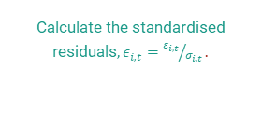
Research Methodology : GSEV
01
02
03
04
AR(1)-EGARCH(1,1)
Standardised Residuals
Univariate NCT
Skewed-T
Obtain parameter estimates, conditional variances, and residuals
Calculate the standardised residuals$, ε_{i,t}={ε_{i,t}}/{σ_{i,t}}.$
Fit the univariate distributions to $ε_{i,t}.$
Fit univariate skewed-t distributions to each vector of residuals from step 2 by MLE

Slide 14
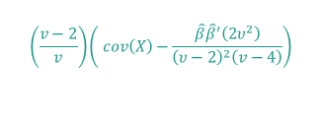
Research Methodology : GSEV (continued)
05
06
07
08
Covariance Matrix
Z
W
X
$$\left(\frac{v−2}{v}\right)\left( cov\left(X\right)−\frac{\hat{β}{\hat{β}}^{′}\left(2υ^{2}\right)}{{\left(υ−2\right)}^{2}\left(v−4\right)}\right)$$
Draw N independent d-dimensional vectors from the multivariate Gaussian distribution defined by N(0, cov)
Draw N independent random numbers from the inverse gamma distribution defined by IG(v/2, v/2)
Substitute Z and W into the to yield multivariate skewed t variables

Slide 15
Research Methodology : GSEV (continued)
09
10
11
12
Cumulative Distribution
Transform X
Innovations
Simulate
Approximate the cumulative distribution functions for the univariate marginals by numerical integration
Based on Step 8, into uniformly distributed variables using the univariate cumulative distribution functions
Convert Usk to innovations, Isk, using the inverse cumulative distribution functions for the univariate piecewise distributions developed in Step 3.
From an AR (1)-EGARCH (1,1) model for each asset i using innovations, I, and parameters θiE.

Slide 16
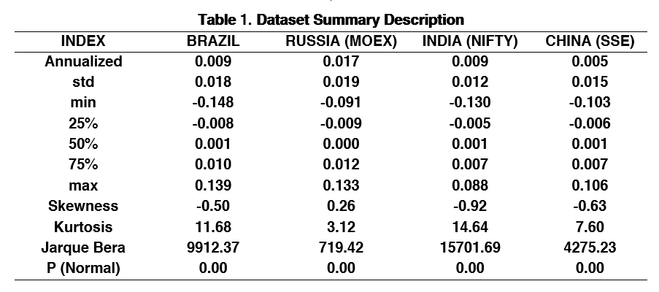
Empirical Results

Slide 17
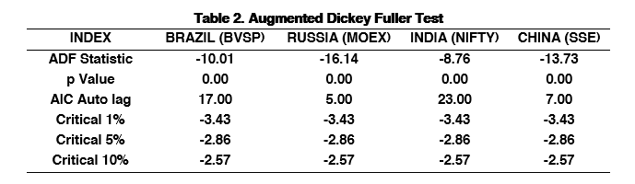
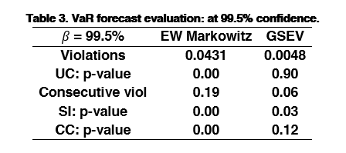
Empirical Results (continued)

Slide 18
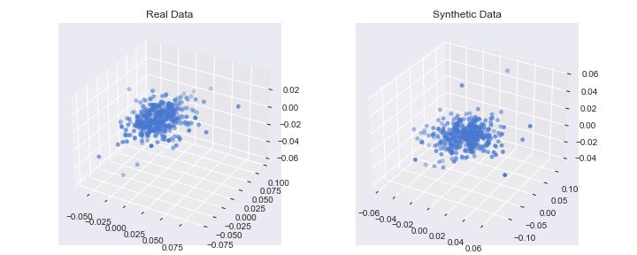
Empirical Results (continued)
Simulated Data From GSEV

Slide 19
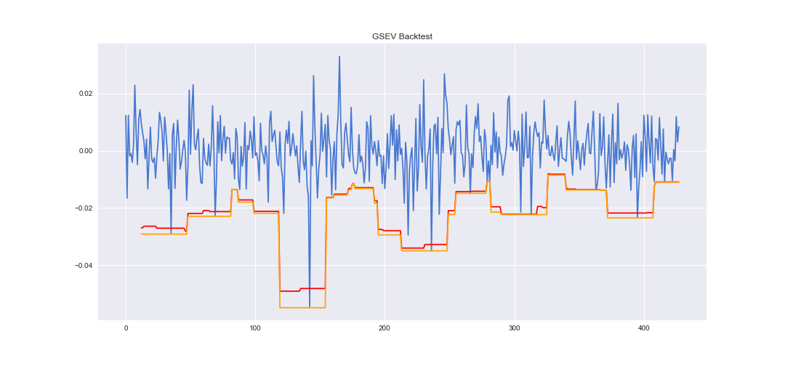
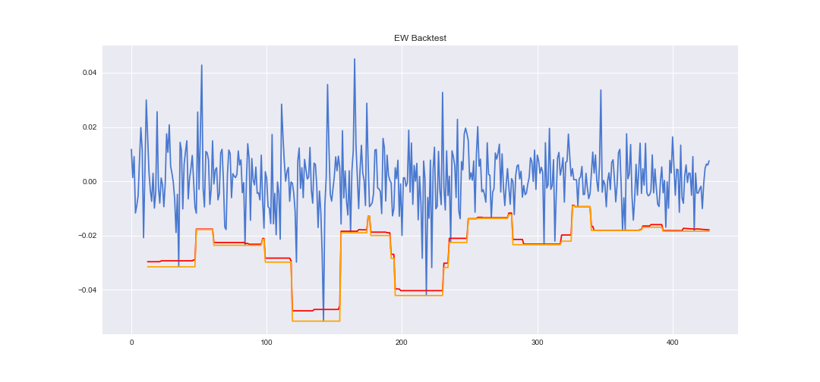
Empirical Results (continued)
Model Performance - Graphical Representation

Slide 20
Conclusions
It is apparent that there exists significant autocorrelation and the absence of unit roots in data.
The violations of out-of-sample CVaRs of the EW model are significantly higher than the target.
The GSEV approach, on the other hand, produces CVaRs that are similar to the target level producing the smallest risk forecast error.
Since the copula imposes a consistent dependency structure across asset pairs, the approach's output is likely to deteriorate as the number of assets and complexity grows.

Slide 21
Conclusions
Conditional volatility approaches tend to be an important component of a sensible VaR estimation model since they reduce the proportion of consecutive breaches.
We conclude that the GSEV method outperforms mean–variance in our out-of-sample portfolio rebalancing study.
The GSEV approach has the potential to provide significant value addition while minimising risk.
Managers can use a conditional volatility model to quantify fat tail risk and optimise investment portfolios if asset return volatility is stochastic and clustered.

Slide 22
Future Prospect
The GSEV approach produces more reliable VaR forecasts than the GGEV approach, which employs a symmetrical dependency structure, suggesting the significance of accounting for asymmetric dependence.
We believe that these findings are applicable to other risk control procedures, but we'll leave that to further study.
Finally, when calculating VaR and evaluating portfolio weights, investors should consider asymmetric dependency. More work is to be done to model these patterns rigorously.

Slide 23

Thank You

